Slide 1

Cover

Slide 2

Cover

Slide 3

Cover

Slide 4

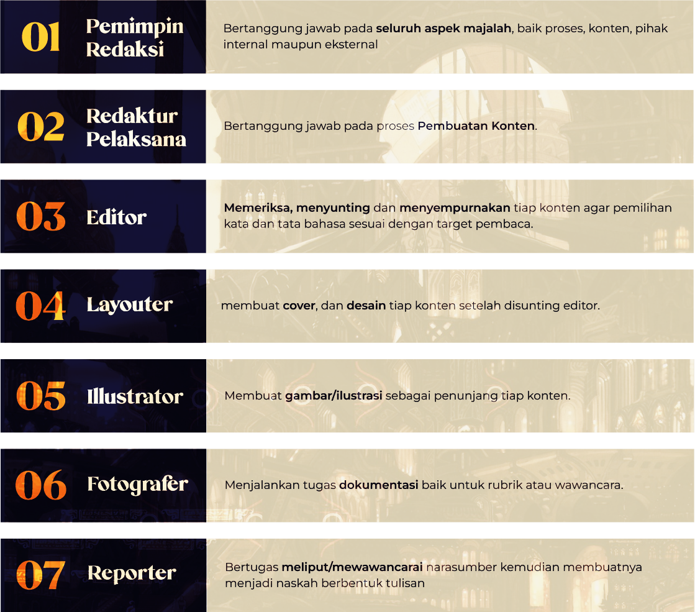
Cover

Slide 5
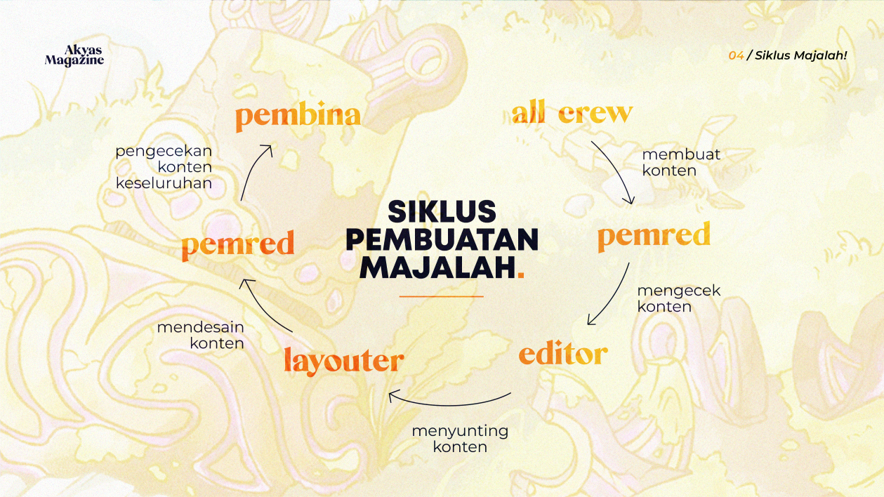
Cover

Slide 6
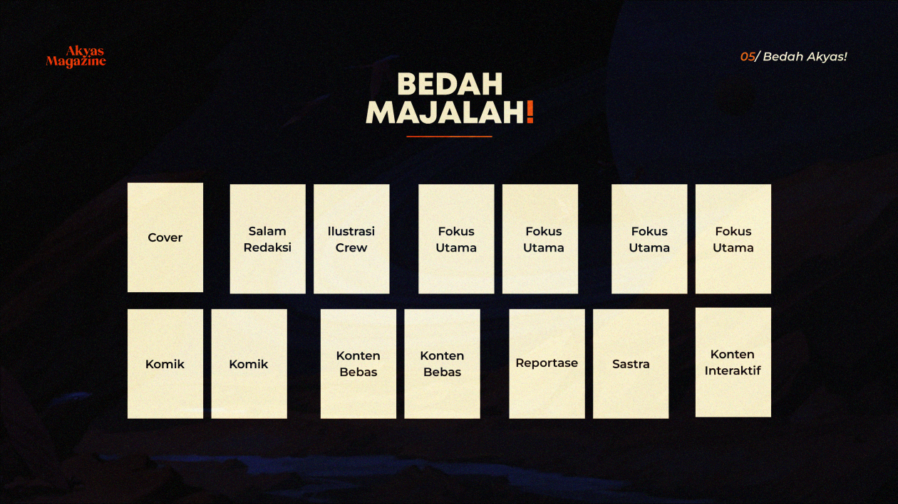
Cover

Slide 7

Cover

